Slide 1

Sigma Security
TEAM GRINDSET
Ale | Bono | Paolo | Stu | Tim

Slide 2
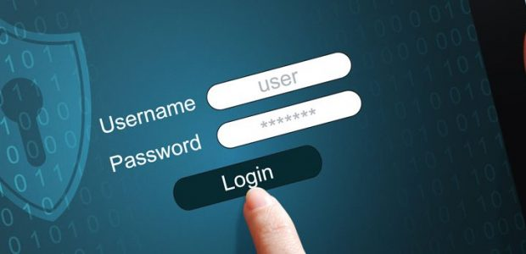
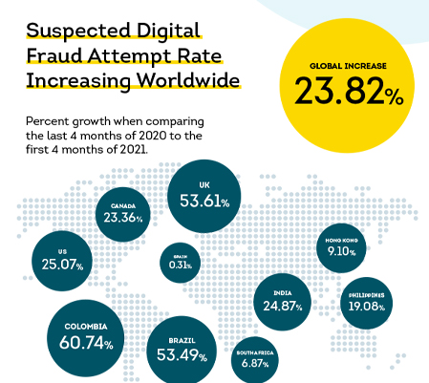
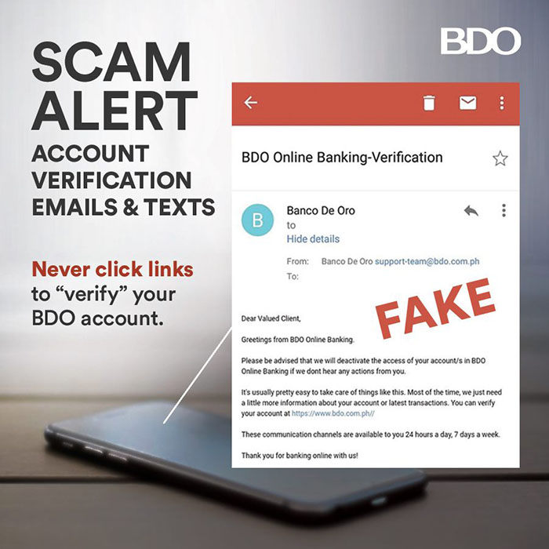
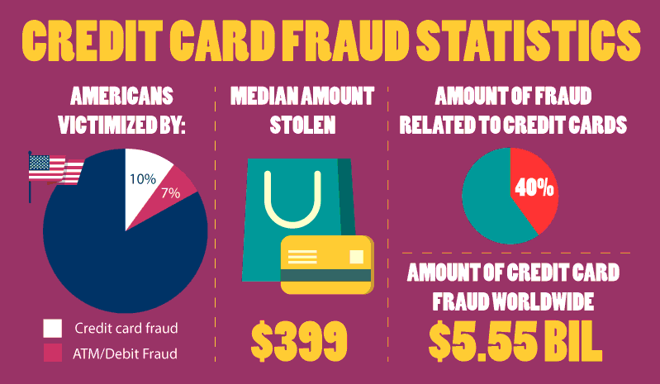
Fraud is real
It happens in different business levels.

Slide 3

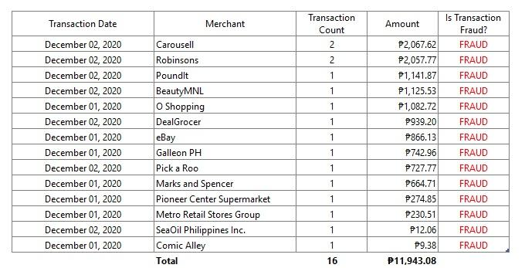
John is a Eskwebank customer who unfortunately is also a victim of fraud

Slide 4
What security features does Eskwebank have today?
No second layer of security implemented
No authenticator for customer transactions
No functionality to flag possible fraudulent transactions

Slide 5
Problem Statement
How will OTP / Authenticator help flag fraudulent transactions in Eskwebanks and help customers like John?

Slide 6
Data Sources
1
2
3
Transaction Data
Merchant Data
Customer Data
4
5
6
Location
Amount
Is Fraud?

Slide 7
Methodology
Model Training with new features
Conclusions & Recommendation
EDA and Cleaning
1
2
3
4
5
Sigma Sandbox API
Initial Modeling & Feature Engineering
Model Comparison

Slide 8
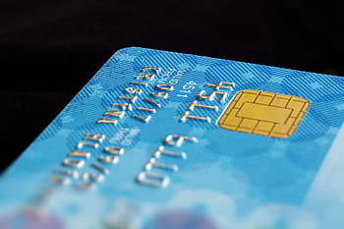

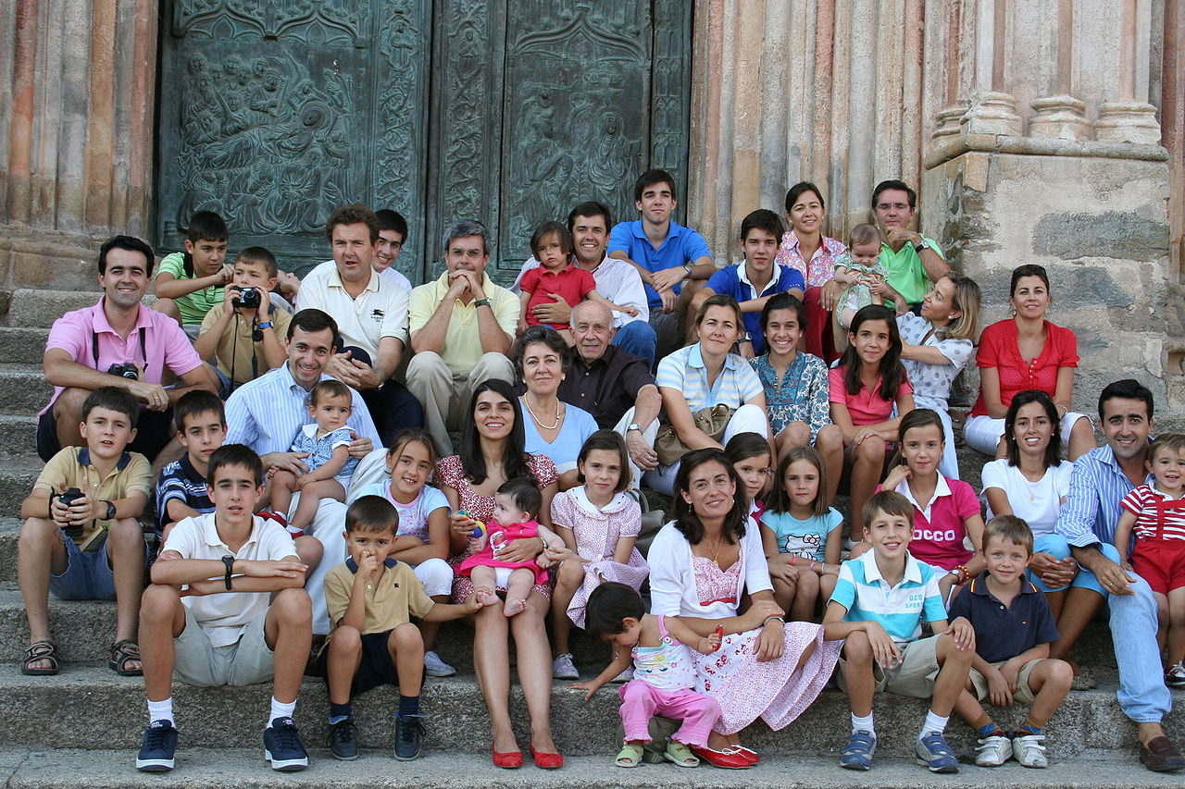

Feature Engineering
The group defined and derived 4 new features for consideration
Credit Card Type
Distance
Age
Days before a holiday
Notes:
Credit card type - credit card provider based on the card number
Distance - from user’s home to merchant’s location
Age - relative to Dec 10, 2021
Days before a holiday - considered xmas, valentines and shopee/lazada n/n sales

Slide 9

Model Performance
 | Logistic Regression | Random Forest | XGBoost
Precision | 89% | 91% | 96%
Recall | 74% | 76% | 98%
f1-score | 81% | 83% | 97%
Accuracy
We chose the metric RECALL to identify how many are the true positives (Fraud) among the transactions. XGBOOST is the best model, as it is able to correctly tag fraudulent transactions 98% of the time.

Slide 10
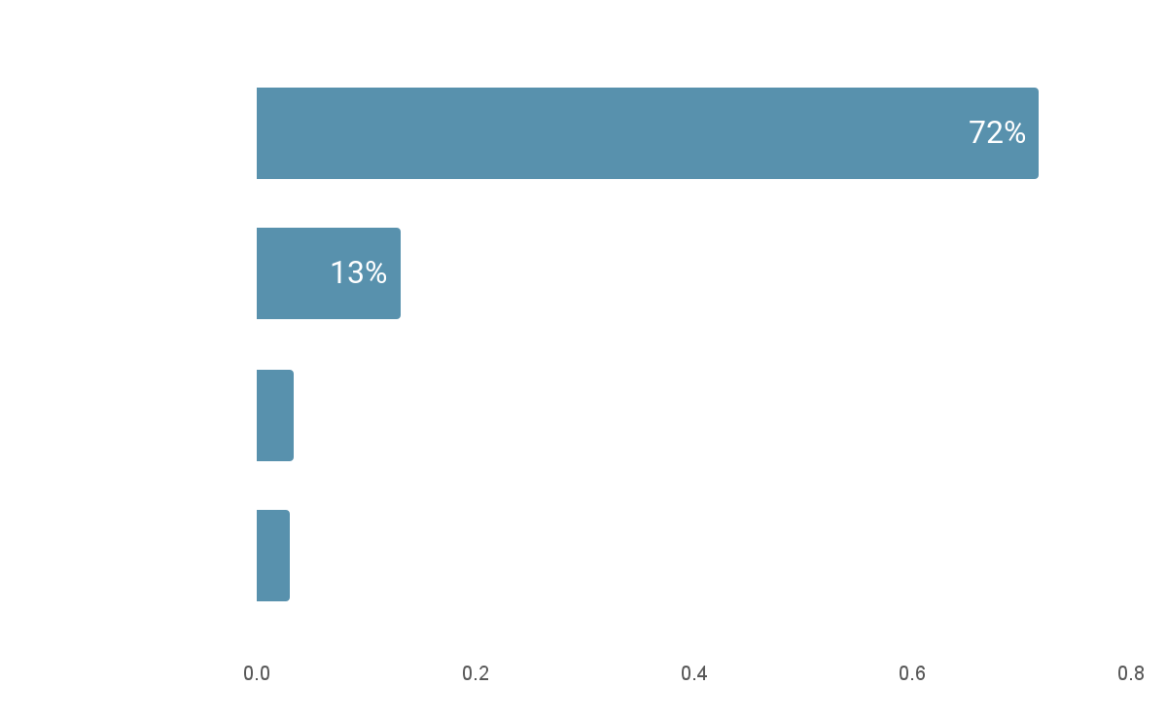

Feature Importance
These are the top features to consider if the transaction is or will be fraud

Slide 11
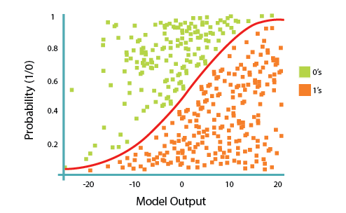
Logistic Regression
02
Process Visualized
Classification Scores
 | Precision | Recall | f1-score | Support
Not Fraud | 0.78 | 0.91 | 0.84 | 2872
Fraud | 0.89 | 0.74 | 0.81 | 2872
Accuracy |  |  | 0.83 | 5744
Macro Average | 0.83 | 0.83 | 0.82 | 5744
Weighted Average | 0.83 | 0.83 | 0.82 | 5744
Logistic regression is a predictive analysis. Logistic regression is used to describe data and to explain the relationship between one dependent binary variable and one or more nominal, ordinal, interval or ratio-level independent variables.

Slide 12
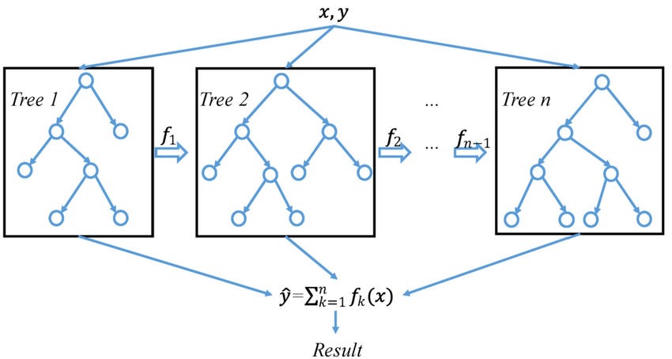
Gradient Boosting (XGBoost)
Process Visualized
Classification Scores
 | Precision | Recall | f1-score | Support
Not Fraud | 0.98 | 0.96 | 0.97 | 1936
Fraud | 0.96 | 0.98 | 0.97 | 1894
Accuracy |  |  | 0.97 | 3830
Macro Average | 0.97 | 0.97 | 0.97 | 3830
Weighted Average | 0.97 | 0.97 | 0.97 | 3830
Gradient boosting relies on the intuition that the best possible next model, when combined with previous models, minimizes the overall prediction error. The key idea is to set the target outcomes for this next model in order to minimize the error
Source: https://www.researchgate.net/figure/A-general-architecture-of-XGBoost_fig3_335483097

Slide 13
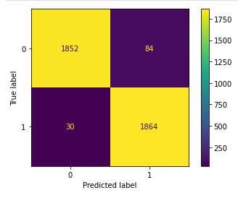
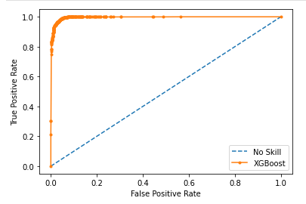
XGBoost - Confusion Matrix and ROC Curve

Slide 14
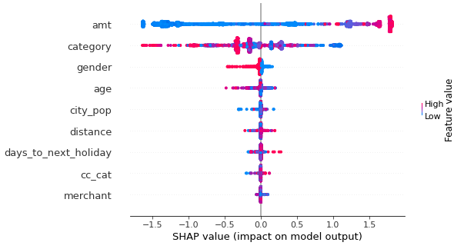
XGBoost - SHAP Output
Higher value transactions are more likely to be classified as fraudulent.
Transaction date is also a factor. The farther away from a holiday, the more likely the transaction is to be classified as fraudulent.
Gender is another factor, transactions by females are more likely to be classified as fraudulent.

Slide 15
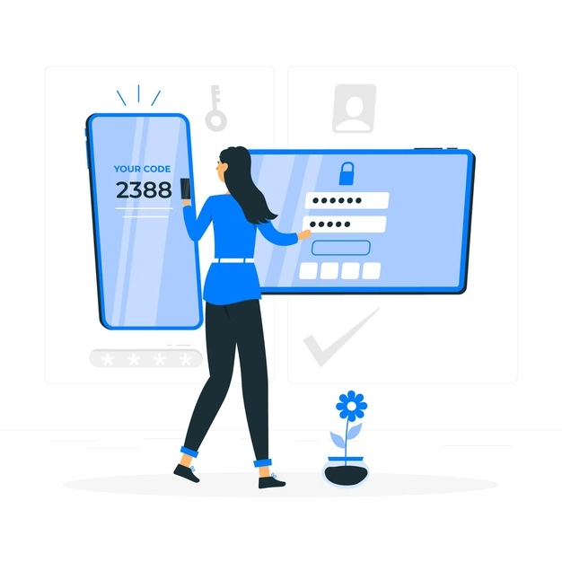
Solution Description
Notes:
Our recommend process

Slide 16
Baseline vs Theoretical
Baseline
Retroactive correction
5.2 million PHP worth of fraudulent transactions
Theoretical
Model triggers OTP for potential fraud to avoid over-aggression
98% or 5.1 million PHP worth of transactions stopped
Notes:
All Transactions have a layer of OTP. Layer of Flagging Frauds.
Conclusion: Recommend OTP for all Transactions
OTP prevents over-aggression on the model. OTP would also help prevent fraudulent critical transactions. Having no OTP for those marked as non-fraudulent helps create a smooth and convenient transaction.
OTP would help address approximately 5.2 Million in losses due to Fraudulent Transactions.
The best model was generated using XGBoost, which has a recall of 98%. This means that 98% of fraudulent transactions would be correctly classified as such.
Since Fraudsters would change their schemes, it is imperative that the model would be continuously updated if we implement this.

Slide 17
Why it’s better than existing solutions
The current solution for EskweBank is clearly not enough seeing as 98.6% of 1000 users have experienced fraud. This amounted to around 5.2 Million in cost to the bank.

Slide 18

How will the fraudsters react?
They will most likely change their patterns. They will try to bypass the OTP.
It is recommended to remind customers to always update their devices.

Slide 19




Which is the best OTP for EskweBank?
Notes:
OTPs can be accessed via email, sms, or an authenticator app. However, emails are vulnerable to hacking with phishing. SMS is also vulnerable to sim swapping where hackers can convince telco companies that they are the victim. Given that the victim is a target of fraud, it is also likely their emails and phone numbers are compromised as well.
The safest way to establish a 2FA OTP is through an authenticator app. It generates an OTP that changes in a short time which secures it from being intercepted.
If possible, it is recommended that OTPs be set up only through the app. Of course, the company must provide guides on setting these up and selling these benefits to convince the customers. But should the company decide that customer preference is more important, SMS and email OTPs are more secure than no OTPs.

Slide 20
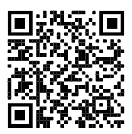
Sigma Security
Our Model Sandbox
TEAM GRINDSET
Ale | Bono | Paolo | Stu | Tim

